Slide 1


Medicaid Academy: Kentucky 1915(i) RISE Initiative
Session 6: Compliance, Quality Assurance, and Improvement

Slide 2



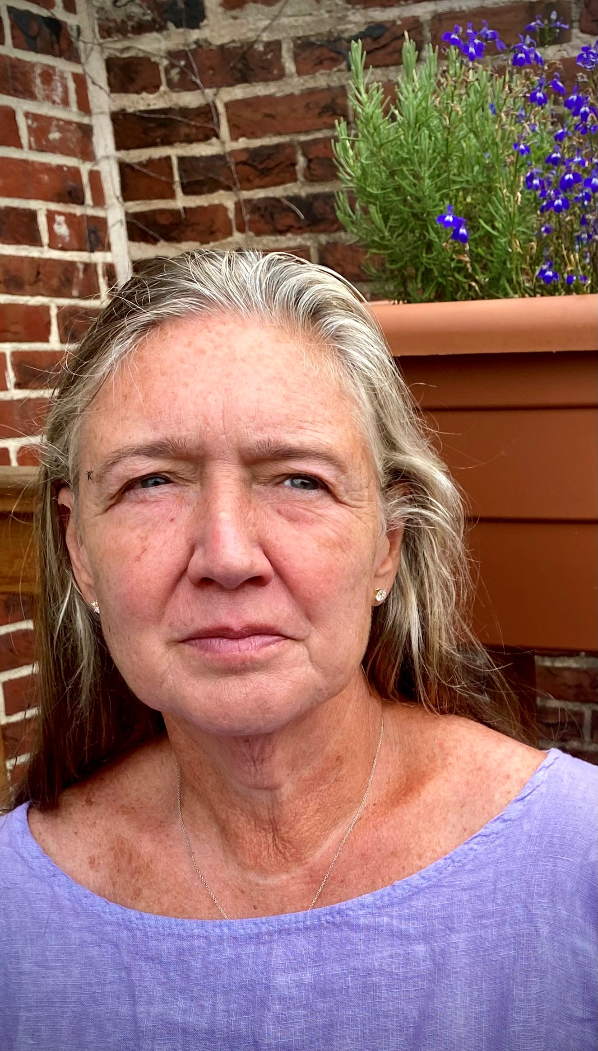


Your Training Team
Leah Werner
Director OH, KY & TN
Project Manager of Academy
Abiola Animashaun-Amutah
National Consulting
Senior Program Manager
Lawrence Vinson III
National Consulting
Senior Program Manager
Marcella Maguire, Ph.D.
Director,
Health Systems Integration
Terri Power, LiSW
Associate Director,
OH, KY & TN
csh.org
Notes:
Leah W

Slide 3
Quick recap from our last session
Through the Medicaid Academy series, your team is building a comprehensive 18-month work plan to consider and become a 1915(i) RISE service provider offering Housing and Tenancy Supports. CSH is here to help you do this, step by step!
In Session 5, we reviewed what is required to document and bill Medicaid FFS for 1915(i) RISE services
  Successful billing requires clear, detailed, Medicaid-compliant documentation (including case notes)
  Providers can submit claims for services electronically or via a paper form (electronic is preferred)
  Providers will need dedicated staff – and integrated, cross-department support – to successfully bill for 1915(i) RISE services
Missed the previous session? Medicaid Academy materials are available here: - CSH Medicaid Strategy Resources

Slide 4
Since our last session, we hope you have had time to:
Added to your workplan
  Reviewed the KY Services Budget Tool and began to input your agency data, especially revenue projections
  Created a plan to revise your agency’s documentation and billing processes to maximize potential revenue outlined in the KY Services Budget Tool
  Identified clear deliverables, responsible parties, and timelines for next steps for documentation and billing
Missed the previous session? Medicaid Academy materials (recordings and tools) are available here: - CSH Medicaid Strategy Resources

Slide 5
Training Cycle
Week 1- LEARN in a training session with CSH
Week 2- Q&A about the above topic with CSH
Week 3- Internal meetings to update workplans
Notes:
Lawrence
Here's the rhythm we'll follow for each of the six topics: a three-week cycle that repeats throughout the Academy.
Week 1 is the Learning Session—that's what we're doing right now. A focused training session where we cover the content, introduce the tools, and give you time to begin your work planning.
Week 2 is the Q&A Office Hour. This is intentionally scheduled a week after the Learning Session because the best questions don't surface immediately.
Week 3 is your Internal Team Meeting time. This is when your full agency team—not just whoever attended the training—comes together to process the material. You'll review what was covered, discuss implications for your organization, and update your workplan with new tasks and deadlines.
This cycle repeats six times over 18 weeks. By the end, you'll have a comprehensive workplan that charts your path to sustainable Medicaid billing.

Slide 6

Medicaid Academy Schedule
Session​ | Topic​ | Date​ | Link ​
6. ​ | Topic #6: Quality Services ​ | May 14, 2026​ ​ | https://csh-org.zoom.us/j/84928386222?pwd=h8Fww3w4ousoBxaUBv2PBa5AoxhWtG.1 ​
​ | Office Hour Q&A on Topic #6​ ​ | May 21, 2026​ | https://csh-org.zoom.us/j/87401139749?pwd=b0txjUsbWOxbifa7wpAJNWRRnNIWKw.1 ​
csh.org

Slide 7
Your Team Includes
Executive Lead
Program Lead
Fiscal Lead
Quality Lead
csh.org

Slide 8

Plan for Today:
Understand the difference between Quality and Compliance
Understand the elements of effective quality improvement planning and continuous quality improvement
Review quality and monitoring requirements for the Kentucky 1915(i) RISE program
Review considerations for monitoring, compliance, and quality improvement planning
Session 6
csh.org

Slide 9
Shared Documents
Session #1: Work Plan
Session #2: Participant Enrollment Tools
Session #3: CSH Services Budget Tool
Session #4: Policies and Procedures Template
Session #5: Documentation and Billing Guidance
Session #6: Ensuring Quality Services Resource
csh.org

Slide 10
Quality and Compliance Activities
Compliance
Quality
csh.org

Slide 11

What is Compliance?
Picture courtesy of Society of Research Administrators International (SRAI)
Elements of compliance include:
Written Policies and Procedures
Compliance Leadership and Oversight
Training and Education
Effective Lines of Communication with either an internal Compliance Officer or external monitoring organization
Enforcing Standards: Consequences and Incentives
Risk Assessment, Auditing, and Monitoring
Responding to Detected Offenses and Developing Corrective Action Plans
Building on documentation and leading to successful program billing, compliance aligns each organization’s practices and documentation processes to local, state, and federal requirements for a program
csh.org
Notes:
This is an overview of why QI is important – and it isn't just about funding requirements.
It really does impact the quality of your programming and the services provided to residents/clients.
It does that by analyzing different aspects of your program – from beginning to end
Provides a framework and structure to do the analysis and evaluations – which we’ll talk about here
A quality improvement program can also keep programs moving forward in an ongoing manner. As we’ve discussed, it isn’t just about setting up the program, but keeping it going.

Slide 12
What is Quality Improvement?
Why
Required
Improves quality of programs
Provides essential program & agency information and data
Helps with grants & funding
Improves outcomes
Improves polices & procedures
Keeps agency in compliance with all standards, rules & requirements
These elements of quality improvement incorporate and build upon key compliance program elements
csh.org
Notes:
This is an overview of why QI is important – and it isn't just about funding requirements.
It really does impact the quality of your programming and the services provided to residents/clients.
It does that by analyzing different aspects of your program – from beginning to end
Provides a framework and structure to do the analysis and evaluations – which we’ll talk about here
A quality improvement program can also keep programs moving forward in an ongoing manner. As we’ve discussed, it isn’t just about setting up the program, but keeping it going.

Slide 13
Why is Quality Improvement Important?
A quality improvement approach:
Refines provider alignment to key programmatic goals
Helps organizations identify needs and resources (e.g., training, physical materials, and IT integration)
Helps organizations clarify who does what to serve clients in need (especially clients with behavioral health needs experiencing housing instability or homelessness)
Ultimately, quality improvement helps each organization serve, track, and get credit (Medicaid reimbursement) for serving their clients the way each client chooses
csh.org
Notes:
New slide – script TBD

Slide 14
Taking a Quality Improvement Approach
Quality Assurance (Monitoring) | Quality Improvement
Externally Driven | Internally Driven
Follows organizational structure | Follows systems and processes
Delegated to a few | Embraced by all → everyone’s job!
Focused on individuals, outliers | Focused on processes
Works toward endpoints | Has no endpoints
Retrospective, detection | Proactive, preventive
Focuses on function | Client focus
Punishes/sanctions, finds blame | Rewards innovation, permits failure
csh.org

Slide 15
Model Framework for Quality Improvement
What are we trying to accomplish?
How will we know that a change is an improvement?
What change can we make that will result in improvement?
Act
Plan
Study
Do
csh.org

Slide 16
Quality Practices Result in Positive Outcomes
POSITIVE SUPPORTIVE HOUSING OUTCOMES
Tenants stay housed
Tenants are satisfied with services and housing
Tenants increase their income and employment
Tenants improve their physical and mental health
Tenants have social and community connections
csh.org
Notes:
Where Quality Practices will result in Positive Outcomes.
Outcomes in which, People stay housed,
Tenants are satisfied and you know because you have multiple processes in place to hear from them directly and do something when they say something, and follow-up to ensure it meets the need
Tenants thrive in supportive housing and can increase their income with employment or benefits they are entitled to the point where the move on from supportive housing.
People improve their physical and mental health after addressing Maslow's higher archy of needs and managing their health utilizing primary care and routine preventative care instead of costly crisis care like ERs and psychiatric hospitals.
Tenants owns the concept of the housing as their housing, where they have a voice in the decisions being made in the community, they are contributing to the beautification efforts, they are socializing in their community and helping to support the housing being a positive investment for the future.
it is important to understand and measure the quality of individual aspects of supportive housing, such measures are meaningless if they do not produce positive results for tenants. There are many outcomes that an organization may wish to track, but the five outlined here are the core outcomes that all successful supportive housing should observe. DOQ help organizations understand how to create and operate supportive housing that will best achieve these outcomes. CSH encourages organizations to know their baseline performance with regard to these outcomes and use them to set aggressive targets for improvement.
Do your current funders measure success the same way? Which of these do your funders currently utilize?
Notes from the DOQ Guidebook:
Tenants Stay Housed Supportive housing is designed to break a cycle of housing instability for tenants and ensure they remain in permanent housing.
• Tenants stay in permanent housing. This is inclusive of tenants who exit supportive housing to other permanent housing.
Tenants Improve Their Physical and Mental Health Supportive housing and associated services help tenants to access needed physical and mental health care and improve their health status.
• Tenants promptly receive any needed medical care, including preventive care.
• Tenants promptly receive any needed mental health care.
• Tenants with mental health challenges report progress toward recovery since entering supportive housing.
• Tenants strongly agree: “Staff helped me obtain information I needed so that I could take charge of managing my illness.”
Tenants Increase Their Income and Employment
Tenants increase their income in supportive housing by obtaining benefits and/or employment. In cases in which tenants are already employed or receiving all benefits for which they are eligible, they maintain their income.
• Tenants who have been in supportive housing for one year or more have increased their income.
• Tenants who enter supportive housing with income and/or employment have maintained it.
• Tenants who express a desire to work are supported and ultimately, successfully employed.
Tenants Are Satisfied With the Services and Housing Tenant satisfaction is an important outcome that ultimately affects the quality of life for tenants and the ability of supportive housing projects to help tenants achieve housing stability.
• Tenants are satisfied with their housing.
• Tenants are satisfied with the services available to them.
Tenants Have Social and Community Connections Supportive housing helps tenants to develop connections to their community and build social support networks.
• Tenants are active community members who choose to participate in organizations such as faith communities and peer associations, and/or in activities such as volunteering, voting, community gardens or block parties.
• Tenants report a strong social support network.

Slide 17
Quality Practices Vary by Funder
Quality metrics are set at the onset of the program; funding for program is approved and distributed before activities
Periodically (e.g., quarterly or annually), the agency provides metrics and updates to evaluator
Evaluator reviews and approves submissions, then metrics are compiled for end-of-year report before new funding begins
Grant-funded quality and compliance review process
State sets quality metrics before approving service reimbursements; agency is informed
Services are approved, reimbursed, and the agency provides metrics and updates to the evaluator
Agencies provide services and submit paperwork for Medicaid reimbursement
Evaluator reviews and approves submissions, then metrics are compiled for end-of-year report before new year begins
Medicaid quality and compliance review process
Agencies (and states) may need to repay Medicaid payments if evaluator finds discrepancies
csh.org
Notes:
New slide – script TBD

Slide 18
Growing Your Quality Improvement Program
Documentation
Chart Reviews
Preparing for Audits
Continuous Quality Improvement
csh.org
Notes:
BHDID's monitoring tools are available to certified providers in advance of monitoring, so they know what will be reviewed. We don't intend it as a "gotcha," but a collaboration to ensure consistent service delivery across providers. In fairness, also need to mention that serious/prolonged non-compliance may result in loss of certification.
Resources are available at this address: https://www.chfs.ky.gov/agencies/dbhdid/Pages/1915irise-provider-resource.aspx

Slide 19
Common Quality Improvement Plan Elements
Reviews
Client Chart
Medicaid Compliance
Program Outcome Measures and Funder Requirements
Staff Training Plan
Billing
Targeted
Client Satisfaction Surveys
Focus Reviews
Program and Services Overview
Program and QI staff Responsibilities
Policy and procedure review
csh.org
Notes:
These are some common sections of a QI plan.
Program and Services Overview – brief description of each program and the services involved. It could include the goals and objectives of each program and maybe bullet point the services. Doesn’t’ have to be in detail. Like we discussed in developing policies – you want them broad enough so you don’t have to revise them each time you add or take away something.
Program Staff Resp. – here you can outline the job responsibilities for each staff position – not each staff person. Again, in a broad description. You especially want to point out what their responsibilities are as they relate to the QI process. As we go through the next few slides, that will become clearer.
Reviews – review each of the reviews, highlighting the goals of each one and how they differ.
Program outcomes – it’s important to talk with your program staff about the outcomes they want to measure and HOW they’re going to measure them. Cheryl is going to talk about program outcome measurement later. There’s some up front work that is very helpful when discussing outcomes – especially related to the “why” you are measuring something, for example what you hope to learn; the “what” you will be measuring, for example what data will you be collecting, will you be comparing it to baseline information or something else; the “how” you’re going to measure it, for example, from whom, how often and what tools will you use and how will you analyze and evaluate the data after it’s collected; the “when” you will be measuring, for example, what timeline will you be using; every 6 months, year, quarterly, etc. And finally the follow-up – what will you do with the information after its collected and analyzed.
Staff training – we’ve addressed this in previous webinars, but as a reminder, it’s impt to have a plan for training that is organized and a person that will be the gatekeeper to alert program managers of what training is due when and by whom and keep track of when training is completed.
Surveys – we’ll be getting into that in more detail in a bit. Impt to note here that the plan should include the types of surveys you plan to have for that year, who will conduct the surveys, who they will be conducted and the plan for analyzing and disseminating the results.

Slide 20
Staffing and Supervision Considerations
Expertise and Skill Level
Caseload Size
Supervisors
Training
csh.org
Notes:
What is staff degree? Experience? Skill?
Expertise and skill level don’t just mean clinical skills and interaction with clients, also means documentation skills. There could be a big learning curve.
Licensure – currently QMHP can still bill for CPST. At VOAGO we changed job descriptions to better fit the CPST responsibilities. Staff left, director left
Caseload size – remember there is a lot more demand for paperwork & training so need to make sure that caseload sizes are appropriate. VOAGO was 12 – 13. Through team meetings, all the staff knew all the clients so they could fill in when needed.
Supervisors – me AND we hired an additional position - LSW. Director wasn’t licensed – but had A LOT of case management experience. The new position was the clinical supervisor – a bit tricky but they worked it out. New LSW did assessments – goal was for her to work with the kids but initially she did all the adult assessments.
Depending on the level and experience of staff, that determined the amount of training they needed.
Two types of training: clinical to meet compliance, and the intricacies of Medicaid billing and documentation.
I mentioned a bit ago about all the time I spent reviewing notes, I also spent a lot of time training staff on proper documentation. Also, sent them out. Refer back to capacity grant which helped with this cost.

Slide 21

Gathering and Incorporating Stakeholder Input
Community Meetings or Open Houses
Focus Groups
Contact information for Client Rights Officer or other neutral party in tenant newsletter
Suggestion boxes
Maintaining an anonymous voice mailbox for comments
Satisfaction Surveys
csh.org
Notes:
Facilitator solicits: Who is a stakeholder??
Possible Answers:
Tenants, Tenants’ family members, Staff, Board Members, Neighbors, Funders, Local Police, etc.
Today we’re going to focus on tenants as stakeholders.
Anyone with an interest or “stake” in the supportive housing, or who is somehow impacted by the supportive housing, is a stakeholder.
Facilitator reviews indicators (below) regarding Tenant Satisfaction Surveys
Facilitator solicits other ideas for obtaining tenant input and then for obtaining other stakeholders’ input.
Indicators of Quality:
A Tenant Satisfaction Survey that addresses tenants’ experience of both property management operations and of supportive services delivery is administered with current tenants at least annually, and with all tenants who are moving out.
The Tenant Satisfaction Survey is provided in tenants’ language of origin, is written at an appropriate literacy level, and a neutral party is available to assist individuals with low literacy skills to complete the survey.
Summary reports based upon the data gathered from stakeholders are shared with all individuals who contributed data or input.

Slide 22

Tenant Survey
Tenant Survey editable word doc, English
Tenant Survey, editable word doc, Spanish language version
csh.org
Notes:
Add links when available – Tenant Survey should be added to Quality Toolkit when it is back online – Ask Ari about status.
Otherwise, you can share here: CSH Tenant Satisfaction Survey Template 2022.docx

Slide 23
What Do You Do With All the Inputs?
Review and revise policies and procedures, house rules
Discuss feedback and findings at tenant and QI Committee meetings to identify action steps and timelines for implementation (when feasible)
Create new social, advocacy, or training opportunities within and beyond your agency
Identify potential partners and champions – both within and outside your organization – that can help tell the story of how, when and why these inputs were needed
AND MORE! Whatever you do – make it known
csh.org
Notes:
Elicit: What are some ways that staff can use tenant input to make meaningful changes/improvements.
Important to let tenants know the outcome and the reason for it, whether the decision is Yes, No, or Maybe. Make the decisions as transparent and public as possible
EXAMPLES:
Yes, we can have a movie night and we are going to next month.
No, we aren’t going to install a soda machine, because many of our tenants have diabetes and we want to support them in managing their health.
How do you share the results of tenant input?
Time permitting, discuss:
Do tenant input opportunities result in meaningful changes within the involved organizations?

Slide 24
Quality Improvement Strategies
Assign or designate a staff person to lead agency quality improvement strategies (if one is not already identified)
  Reminder: All levels of staff are part of the QI process
Schedule a calendar of client chart reviews and review meetings
Process and timelines for reviewing policies and procedures
Plan for communication of program outcomes, chart review results, programmatic changes, and changes in requirements
Plan for ongoing compliance, including agency-specific and Kentucky 1915(i) RISE Initiative specific QI changes
csh.org
Notes:
All the strategies outlined here are designed to keep the process moving forward, maintain compliance, and be as effective as possible.
Without a designated staff person, things may be too unorganized and important things could get missed. It is an investment but worth it.
Highlight:
All levels of staff must be part of the ongoing process – lay out a process between all staff - for communication and responsibilities going up and going down
Client chart reviews – peer and random billing comparisons
Reviewing policies – needs to be on the board calendar and executive committee, if they review any policies – maybe more procedures
Program goals and outcomes – what did you measure and what was the result. What is the plan for follow up and closing the loop
Client satisfaction surveys – conducted and reviewed – make changes?
Discuss closing the loop

Slide 25
Remember the Importance of Internal Monitoring
Establish Committees
Establish Timelines
Establish Process
Ensure Mistakes are Corrected
csh.org

Slide 26
Closing the Quality Planning Loop
PLAN
DO
CHECK
ACT
Continuous Quality Improvement
csh.org
Notes:
PLAN – planning doesn’t just happen. It is a strategy use to identify a problem; gaps in your programs, or aspects of your services you want to focus on changing or revising. Important to gather data and information and analyze it so you know as much about the situation as possible. Have the right people at the table to make the plan. Also, I can’t emphasize the gathering of data enough. To be able to identify the issues, gaps, set priorities and develop an action plan you must have data and information and good data. And it needs to be realistic –I didn’t say easy, I said realistic. It can be a stretch. Questions to ask:
What gaps do we see in our services OR What issues do we want to focus on
Where and how am I getting my data
what do we want to accomplish?
What changes can we make that will result in improvement?
Who will be responsible for following through the whole processes
DO – now we move to the activities once you’ve planned out your strategy. Select the solution you feel would best fit the problem. It is a good idea sometimes to implement a pilot at this point instead of moving full force into a specific implementation change. Be sure that there is some way of ensuring the activities or solution that was decided upon is followed through, maybe a committee or certain people. Must collect data and implement simultaneously. Questions to ask:
What service or intervention would best solve this problem
What are the resources needed
Should we start with a pilot
CHECK - now you measure the effectiveness of the strategy. Check data on an ongoing basis, don’t wait until the end. Analyze and evaluate the data, what is it telling you? Questions to ask:
Is my data good? How did we get it/where did it come from? Notice in the planning stage you asked, how will I get my data, now you’re asking where it actually came from.
Is the intervention/project/strategy producing the results we thought it would
What isn’t working or producing the results we expected
ACT - what changes would you make based on the checking you did – the analysis of the data. And implement those changes. That is the closing of the loop. Put into practice what was learned throughout the entire process. We design, redesign, train, re-train, communicate – and it goes on.
Questions to ask:
What changes/revisions do we want to make based on the information we have- changes can be in the program areas, processes, data collection methods, data collection tools, staffing, etc.
How do we fully implement it throughout the program and staff
How do we ensure its fidelity
How will we continue to track the outcomes/results – collect data
Will the same person/team serve as the lead

Slide 27
Reminder: quality and compliance don’t end when you receive the contract!
Written Policies, Standards & Agency Procedures
Staff Training & Supervision
Internal & External Audits
Learning & Improving
Corrective Action Planning & Enforcement
Continuous Quality Improvement
csh.org
Notes:
Talk through the following:
Policies and procedures review
Required staff training
Supervision notes
New requirements/rules
Client chart review
Client satisfaction surveys
Audits and recertifications
Let me first say, that quality improvement processes can be an entire separate training.
I’m not going to go into this slide in depth but the important point is that you put processes into place to remain compliant. And here are some items to help with that. It doesn’t end after you get your contract.
Policies usually need to be reviewed annually, may need to be updated as standards may change
Medicaid requires staff to have specific training
Client chart review – peer and compare billing units

Slide 28

Kentucky 1915(i) RISE-Specific Quality Components
csh.org

Slide 29
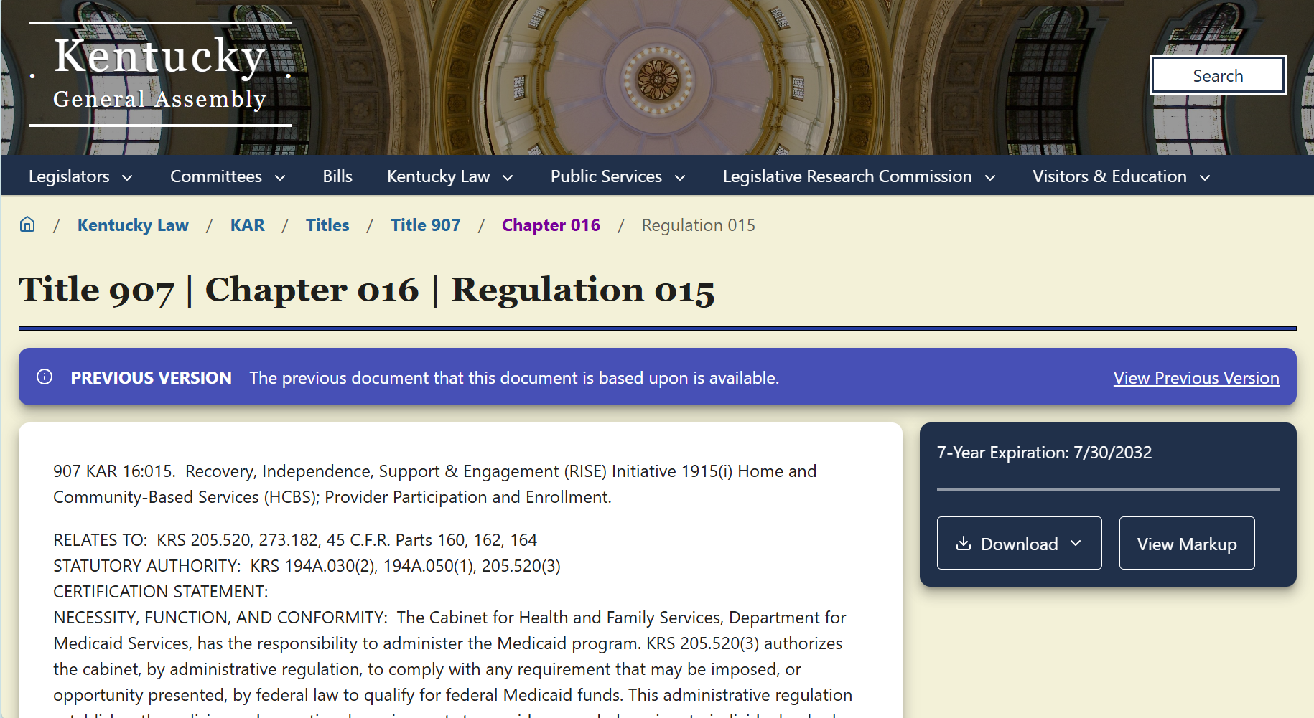
1915(i) RISE Provider Policy and Procedures Legislation
Kentucky 907 Chapter 16:15 lists out provider reporting requirements (the basis for additional documents found in the 1915(i) RISE Program ALM training system)
csh.org

Slide 30
Kentucky 1915(i) RISE Policy and Procedures Submission Details
The Operational Documentation Policies section (Section 10) must include:
Agency operations for organizational structure and timelines for updates
Your organization’s quality improvement plan, monitoring how program findings, corrective actions, and case management quality assurance monitoring are documented, and 1915(i) RISE program goal progress
Your organization’s Human Rights Committee Participation policies and procedures
csh.org

Slide 31
More Details on the Required Quality Improvement Plan
As an overall goal outlined in 907 Chapter 16, Regulation 15, each agency’s 1915(i) RISE Initiative-specific Quality Improvement Plan must:
“Ensure that the participant receives person-centered 1915(i) RISE Initiative services;
Enable the participant to be safe, healthy, and respected in the participant’s chosen community;
Enable the participant to live in the community with effective, individualized assistance; and
Enable the participant to enjoy living and working in the participant’s community.”
csh.org

Slide 32
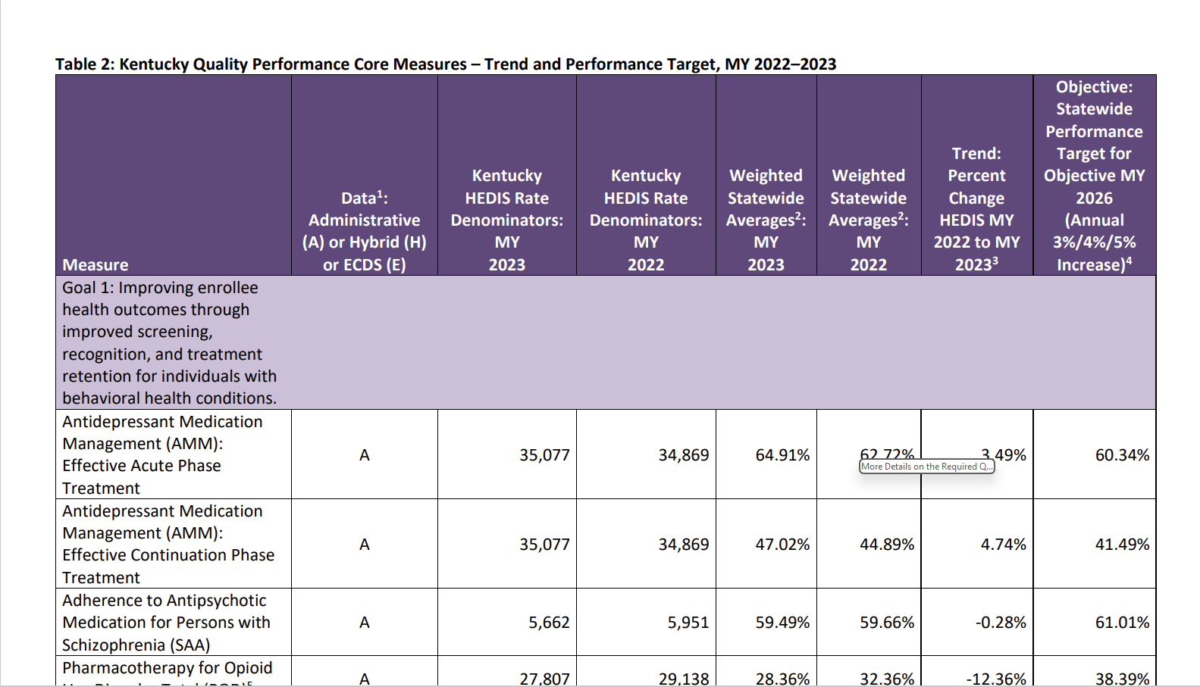
Kentucky Medicaid Quality Requirements
Kentucky DMS requires all Medicaid providers to submit data on the Kentucky Quality Performance Core Measures
The KY Core Measures list combines measures from CMS Adult Core Measures, CAHPS survey series, HEDIS, and National Quality Forum
Measures in FY 2025 evaluation report have new 2026 Statewide Performance targets
csh.org
Notes:
New slide – content to be finalized after state edits

Slide 33
Continuum of Quality Improvement Standards and Measures
Evidence-based best practices and models for providing supportive housing and housing services
Kentucky DMS Medicaid service requirements and quality metrics
Kentucky 1915(i) RISE Service provider quality requirements
Note: CSH’s Quality Supportive Housing Standards fit in this portion of quality measurement and improvement
Best practice recommendations
(high-level, customizable for states)
Payer-specific quality metrics and compliance components (spans across multiple Medicaid programs)
Program-specific quality requirements (funded by Medicaid)
csh.org
Notes:
New slide – content to be finalized after state edits

Slide 34
Interconnected Quality Measures
Other required Medicaid measures important to Kentucky DMS, including:
CAHPS Patient Satisfaction Survey questions (asking about service plan adherence, service preferences, and staff responsiveness)
HEDIS measures related to patient demographics (e.g., race, Medicaid eligibility category)
HEDIS measures for adults receiving specific specialty care (e.g., advance care planning/patient preferences, substance use treatment, behavioral health, and more!)
Data and information found in Kentucky 1915(i) RISE Quality Improvement Plan
Helps answer questions for:
Separate from the 1915(i) RISE program, Kentucky DMS requires Medicaid providers and contracted managed care plans to collect information and report on other quality data points. Although the Kentucky 1915(i) RISE program does not require service providers to contract with a managed care organization (MCO) before service reimbursement, the information collected for the 1915(i) RISE Quality Improvement Plan helps providers meet other Medicaid quality and reporting requirements.
csh.org

Slide 35
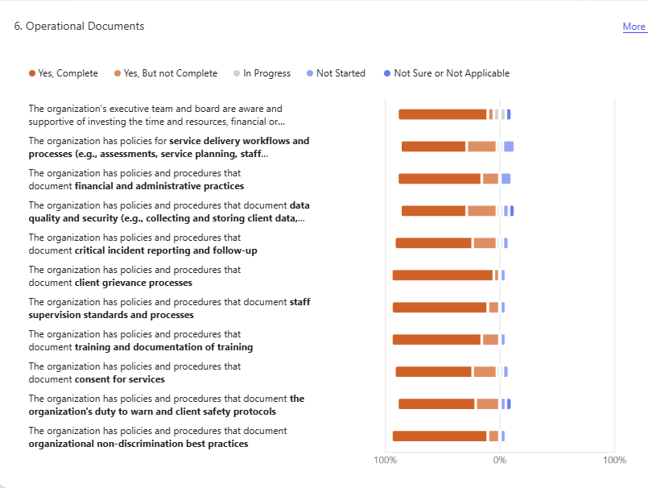
Operational Questions from Kentucky Provider Readiness Assessment
GOOD NEWS: Kentucky providers are already starting from a solid knowledge foundation!
90% of respondents said they have client grievance processes already in place
84% of respondents said they have staff supervision and review standards
84% of respondents said they have non-discrimination best practices already in place
58% of respondents said they have service delivery workflows and processes completed
csh.org

Slide 36

Planning for Updates: When reviewing your agency’s quality and compliance resources, consider:
What needs to be added?
What needs to be revised?
What needs to be started?
Who is the agency lead on quality improvement?
What state are your current quality improvement plans, compliance, and quality planning documents in?
Which departments need to be involved in quality improvement planning?
Who is leading the revisions needed to meet the Kentucky 1915(i) RISE policies and procedures requirements?
How is your organization gathering feedback from staff and service participants to inform the revision process?
csh.org

Slide 37
Simple Outcome Measurement Plan
Outcome Measures
Calculation
Goal
Data Source
csh.org
Notes:
Each outcome has four parts when you are measuring them. We can refer to the plan-do-check-act here. Identify your issue through the planning phase, the calculation is how your going to measure it, on other words how will you be collecting the data. What is your goal that you want to accomplish at the end. And what will be your data source – where will you get the data you want in your calculation. The more you invest in the beginning in the how, why, what, and check periodically – the better.
Data needs to be reliable over time! Can’t be anecdotal. Sometimes things feel differently than they are in reality.
Let’s walk through one outcome.

Slide 38
Outcome Measurement Plan
CORE OUTCOMES MEASURES
Outcome Measure | Calculation | Goal | Data Source
Successful Housing Outcomes: The percentage of tenants entering the housing who either remained housed for at least one year within the supportive housing or who exited to other permanent housing in the community. | The total number of tenants who remained stably housed over a one year period divided by the total number of tenants who were in housing at the beginning of the one year period. | At least 80% | HMIS/APR data, property management records, and/or tenant files.
csh.org
Notes:
Outcome measure:
Successful Housing Outcomes:
The percentage of tenants entering the housing who either remained housed for at least one year within the supportive housing or who exited to other permanent housing in the community.
Calculation
The total number of tenants who remained stably housed over a one year period divided by the total number of tenants who were in housing at the beginning of the one year period.
Goal
At least 80%
Data Source
HMIS/APR data, property management records, and/or tenant files. You can develop your own spreadsheet or other means of measurement as long as its reliable and easy to use.

Slide 39
Outcome Measurement Plan
csh.org
Notes:
Here is an example and template: Outcomes Monitoring Plan - FINAL.xls

Slide 40
Key Takeaways from Today
Quality and compliance programs rely on smart, Medicaid-compliant documentation and staff cooperation
To meet 1915(i) RISE Initiative requirements, providers will need to meet both RISE-specific and Kentucky Medicaid-specific quality metrics
Several resources can help providers plan for 1915(i) RISE Initiative quality compliance
csh.org

Slide 41
Up Next:
Planning Ahead:
What are ongoing TA needs?
Who needs to attend:
Whole team
What do you need to gather and have access to:
Review your work plan?
Where do you need assistance next?
Q&A on this Session
[Date and Time]
csh.org

Slide 42

Thank you!
csh.org

