Slide 1


Medicaid Academy: Kentucky 1915(i) RISE Initiative
Session 4: Policies and Procedures

Slide 2






Your Training Team
Leah Werner
Director OH, KY & TN
Project Manager of Academy
Abiola Animashaun-Amutah
National Consulting
Senior Program Manager
Lawrence Vinson III
National Consulting
Senior Program Manager
Marcella Maguire, Ph.D.
Director,
Health Systems Integration
Terri Power, LiSW
Associate Director,
OH, KY & TN
csh.org
Notes:
Leah W

Slide 3
Quick recap from our last session
Through the Medicaid Academy series, your team is building a comprehensive 18-month work plan to consider and become a 1915(i)RISE service provider offering Housing and Tenancy Supports. CSH is here to help you do this, step by step!
Missed the previous session? Medicaid Academy materials are available here: - CSH Medicaid Strategy Resources

Slide 4
Since our last session, we hope you have had time to:
Added to your workplan
  Reviewed the KY Services Budget Tool and began to input your agency data
Added to your workplan with clear deliverables, responsible parties, and timelines.
Missed the previous session? Medicaid Academy materials (recordings and tools) are available here: - CSH Medicaid Strategy Resources
Notes:
Lawrence

Slide 5
Your Team Includes
Executive Lead
Program Lead
Fiscal Lead
Quality Lead
csh.org

Slide 6

Purpose of Learning Sessions
 | Each session will include:
Provider agencies will learn about a topic critical to being a Medicaid Provider Agency Provider agencies will be given tools to help their Medicaid service delivery, administration, billing and implementation process Provider agencies will be given time to develop an 18 month workplan for the process. Agencies will need more internal time outside of sessions. | Helpful tips and tools provided by the TA team Opportunities for sharing experiences across agencies Coaching for your agency
csh.org

Slide 7
Training Cycle
Week 1- LEARN in a training session with CSH
Week 2- Q&A about the above topic with CSH
Week 3- Internal meetings to update workplans
Notes:
Lawrence
Here's the rhythm we'll follow for each of the six topics: a three-week cycle that repeats throughout the Academy.
Week 1 is the Learning Session—that's what we're doing right now. A focused training session where we cover the content, introduce the tools, and give you time to begin your work planning.
Week 2 is the Q&A Office Hour. This is intentionally scheduled a week after the Learning Session because the best questions don't surface immediately.
Week 3 is your Internal Team Meeting time. This is when your full agency team—not just whoever attended the training—comes together to process the material. You'll review what was covered, discuss implications for your organization, and update your workplan with new tasks and deadlines.
This cycle repeats six times over 18 weeks. By the end, you'll have a comprehensive workplan that charts your path to sustainable Medicaid billing.

Slide 8

Medicaid Academy Schedule
Session​ | Topic​ | Date​ | Link ​
4.​ | Topic #4: Policies & Procedures ​ | April 2, 2026​ ​ | https://csh-org.zoom.us/j/87361406535?pwd=eNEJfNE3vkH7rlyLj23rwaOyQHxa3N.1 ​
​ | Office Hour Q&A on Topic #4​ ​ | April 9, 2026​ | https://csh-org.zoom.us/j/84811338738?pwd=dmbVKTVLfEJlPno9e8eF8wf5BNztI7.1 ​
5.​ | Topic #5: Documentation & Billing ​ | April 23, 2026​ ​ | https://csh-org.zoom.us/j/89680281916?pwd=gzcUAH7LWbRD1j2K7jQHIahYazFrIF.1 ​
​ | Office Hour Q&A on Topic #5​ ​ | April 30, 2026​ | https://csh-org.zoom.us/j/84594719074?pwd=mEm6oA7iJZ0FGB6FCFu0jQrd3qiaE8.1 ​
6. ​ | Topic #6: Quality Services ​ | May 14, 2026​ ​ | https://csh-org.zoom.us/j/84928386222?pwd=h8Fww3w4ousoBxaUBv2PBa5AoxhWtG.1 ​
​ | Office Hour Q&A on Topic #6​ ​ | May 21, 2026​ | https://csh-org.zoom.us/j/87401139749?pwd=b0txjUsbWOxbifa7wpAJNWRRnNIWKw.1 ​
csh.org

Slide 9

Plan for Today:
Review policy and procedure requirements as a Kentucky iRISE service provider
Become familiar with important policies and procedures needed for Medicaid compliance generally
Review key components of compliance and HIPAA best practices for policies and procedure-writing
Review considerations for housing providers when modifying other organizational policies and procedures
Session 4
csh.org

Slide 10

Features of Medicaid-Compliant Policies and Procedures
csh.org

Slide 11

Policies
“A policy is a guiding principle used to set direction in an organization”
Bizmanuals.com
Policies define your strategies, your principles, and your rules.
csh.org

Slide 12

Procedures
“A procedure is a series of steps to be followed as a consistent and repetitive approach to accomplish an end result.”
Bizmanuals.com
Your procedures are about your process.
csh.org

Slide 13
Categories of Policies and Procedures
Operations and Administrative Logistics
Client Services
Billing
Quality, Compliance, and Program Monitoring
When aligning your agency's policies and procedures to state and federal Medicaid requirements, providers must make changes to varying categories of documents:
csh.org

Slide 14
New to Medicaid?
HIPAA
https://www.hhs.gov/hipaa/forprofessionals/training/index.html
False Claims Act
  Federal DOJ on False Claims Act
Anti-Kickback Statute
  HHS on the Anti Kickback Statute
OIG
  “CMS should ensure that Medicaid data are complete, accurate, and timely. This can be achieved through CMS’s monitoring of State-submitted managed care encounter data and by implementing the national Transformed Medicaid Statistical Information System.”
    HHS / OIG Compendium of Unimplemented Recommendations | April 2016
Federal requirements for Medicaid must be incorporated into your organization's policies and procedures
csh.org
Notes:
The AKS is a criminal law that prohibits the knowing and willful payment of "remuneration" to induce or reward patient referrals or the generation of business involving any item or service payable by the Federal health care programs (e.g., drugs, supplies, or health care services for Medicare or Medicaid patients). Remuneration includes anything of value and can take many forms besides cash, such as free rent, expensive hotel stays and meals, and excessive compensation for medical directorships or consultancies. In some industries, it is acceptable to reward those who refer business to you. However, in the Federal health care programs, paying for referrals is a crime

Slide 15
New to Medicaid in Kentucky?
Kentucky Medicaid Provider Enrollment Administrative Regulation: Title 907 Chapter 1 Regulation 672 • Kentucky Administrative Regulations • Legislative Research Commission
Kentucky Provider Licensure Standards: Kentucky Revised Statutes - Chapter 216B
State requirements for Medicaid must be incorporated into your agency’s policies, procedures, and provider application packet
csh.org

Slide 16

HIPAA: Protected Health Information (PHI)
PHI is individually identifiable information relating to the past, present or future physical or mental health or condition of an individual, provision of health care to an individual, or the past, present or future payment for health care provided to an individual.
HHS Summary on HIPAA
HHS Training Materials on HIPAA
csh.org

Slide 17
Health Insurance Portability and Accountability ACT- HIPAA
The Basics
The HIPAA Privacy Rule | HHS.gov
The Security Rule | HHS.gov
What are your policies to maintain confidentiality?
How do you ensure that policies are follow and in a way that monitors can track.
Governs electronic transfer of Protected Health Information or PHI
You are electronically transmitting health information in screenings, assessments and billing.

Slide 18

HIPAA Protects Client Rights
Clients have the right to:
ask and see a copy of their health records
have corrections added to their health record
receive a notice explaining how their health information is used and shared
decide if they want to give permission before their health information can be used or shared for certain purposes, such as marketing
get a report on when and why their health information was shared
know any time their health information privacy was breached
file a complaint with their provider, insurer or the U.S. Government if they believe that their rights have been violated
csh.org

Slide 19
HIPAA Key Terms
Confidentiality
Protected Health Information (PHI)
Personally Identifiable Information (PII)
E-PHI
Covered Entity
Held vs Transmissible Data
csh.org

Slide 20
Confidentiality and HIPAA
Maintain reasonable and appropriate administrative, technical and physical safeguards for protecting PHI and e-PHI.
Ensure the confidentiality, integrity, and availability of all e-PHI they create, receive, maintain or transmit
Identify and protect against reasonably anticipated threats to the security or integrity of the information
Protect against reasonably anticipated, impermissible uses or disclosures
Ensure compliance by their workforce
HIPAA requires that each agency interacting with program participants:
csh.org
Notes:
https://www.hhs.gov/hipaa/for-professionals/security/laws-regulations/index.html

Slide 21
What HIPAA-compliant steps do you need to take to protect patient confidentiality?
Automatic log-outs of electronic records and computers when idle
Password protection
Unique username and passwords for each staff member
Screen covers for phones, tablets, and laptops if used in public places
Noise machines
Monitor copy and fax machines for PHI
Locking doors and cabinets
csh.org

Slide 22
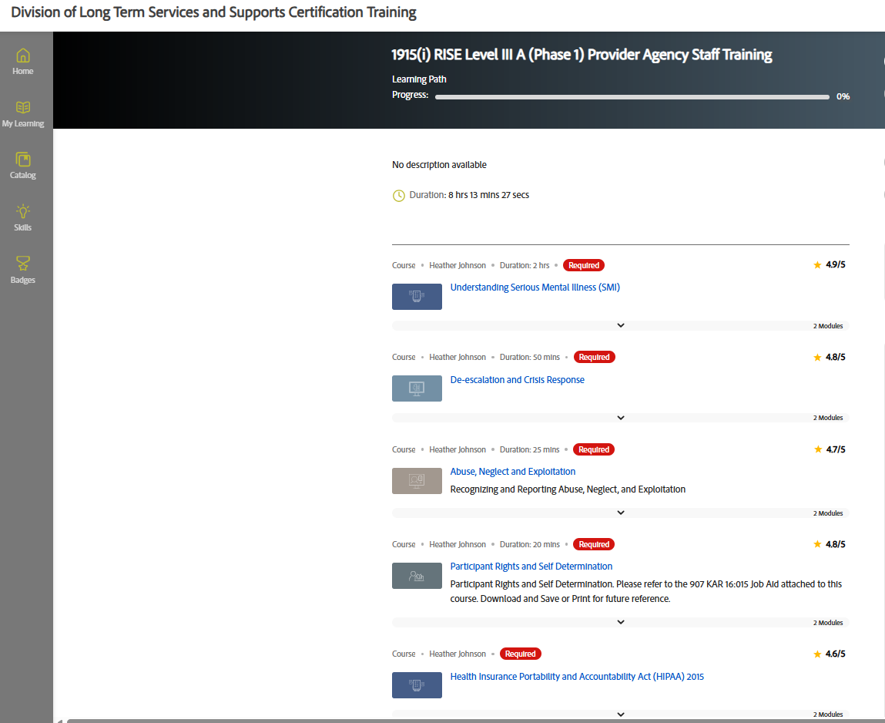
HIPAA in the Kentucky iRISE ALM System
Note: If staff within your agency need a more detailed course on HIPAA and how to protect patient rights, please review the “Health Insurance Portability and Accountability Act (HIPAA) 2015” two-module course as part of the 1915i RISE Level III (Phase 1) Provider Agency Staff training in the ALM system (required course for providers)
csh.org

Slide 23

Security Regulations
Client records are legal documents- EHR or EMR (Electronic health or medical record, most commonly)
Client records include electronic, paper, and scanned records
Under HIPAA, “reasonable steps” must be taken to keep records secure
Your IT department should consult with their consultants/ supports to ensure your systems meet electronic security standards, both for the systems themselves and for transmission of information
Your organization may also have off-site considerations
csh.org

Slide 24
What helps to keep PHI safe in a scattered site model?
Have clear policies and procedures regarding sending electronic records or data to a central records system, copying information, and transportation of paper files
Establish schedules for submitting tenant data to central records
Ensure access to centralized records for staff who travel
When possible, have locked office or storage space at frequently visited sites for paper records
Secure your laptop! Passwords, fingerprint readers
Train staff on how to maintain confidentiality in the community
csh.org

Slide 25
Where might you need to use extra caution when handling PHI?
Include on agency posters and signage prohibitions on:
  Talking about a client in a public area
  Photocopying ID cards and faxing prescriptions
  Handling discharge papers and forms with the client’s name, address, or date of birth
  “water cooler conversations” between two staff members about a client’s care, even if both staff members know the individual
Recommend posted reminders for staff NOT to engage in hallway conversations
csh.org

Slide 26
Suggested
To Do List:
Create and host an annual HIPAA training for all staff who have access to PHI
Review data systems with your vendors for HIPAA compliance.
Perform a risk analysis of your current policies and apparatus to protect confidentiality.
Designate a staff person who is responsible for developing and implementing its security policies and procedures. This is your HIPAA compliance officer.
Revise Policies and Procedures to
  Analyze the risk of a breach and take appropriate measures to limit risk
  Designate staff positions that have PHI access.
csh.org
Notes:
A risk analysis process includes, but is not limited to, the following activities: Evaluate the likelihood and impact of potential risks to e-PHI;⁸
Implement appropriate security measures to address the risks identified in the risk analysis;⁹
Document the chosen security measures and, where required, the rationale for adopting those measures;¹⁰ and
Maintain continuous, reasonable, and appropriate security protections.¹¹

Slide 27

Kentucky 1915(i) RISE-Specific Policies and Procedures
csh.org

Slide 28
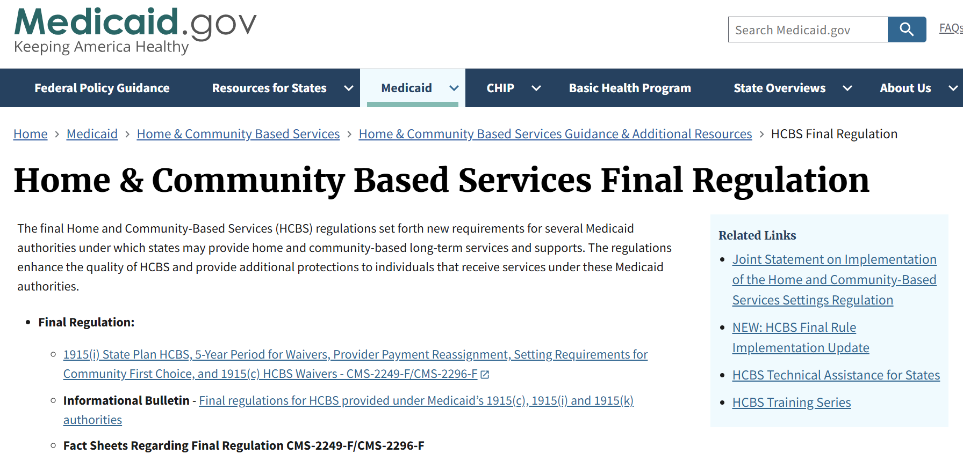
What is a “Setting"?
  Setting means where a person lives
  Critical that this is a place chosen by the individual. CHOICE is a fundamental values in Medicaid and HCBS
  The person should have a lease that has not differences from a non-disabled person's lease.
  Setting should be easily accessible to community resources
  Person Centered Services Plan (PCSP) must reflect the setting and that is was chosen by the individual
  More details of requirements at eCFR :: 42 CFR 441.710 -- State plan home and community-based services under section 1915(i)(1) of the Act.
Home & Community Based Services Final Regulation | Medicaid

Slide 29
Kentucky Specifics for Single-Site Setting under HCBS Setting Rule
Need a citation for the recent decision on single-site locations here
csh.org

Slide 30
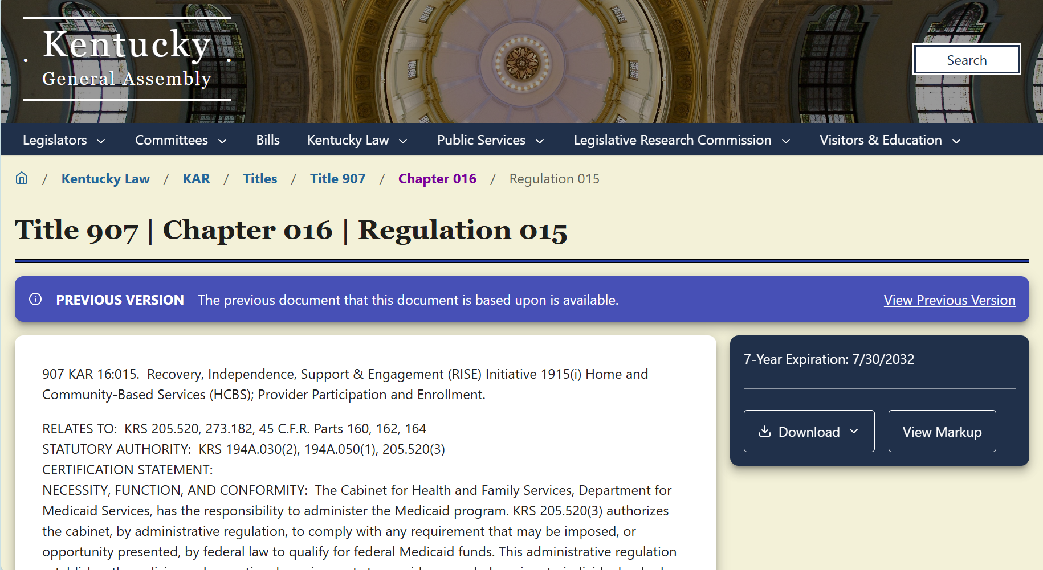
Provider Policy and Procedures in KY KAR
Kentucky KAR Regulation 15 lists out provider reporting requirements (the basis for additional documents found in the iRISE ALM system
csh.org

Slide 31
Websites to Bookmark
DBHDID 1915(i) RISE program
    1915(i) RISE Provider Resource documents
    Provider Agency & Staff Certification Training Outline.docx
    iRISE51.pdf- Details on requirements for Provider Type 51
KY Databases, you are signing into
    Adobe Learning Manager for KY: Required trainings to be a RISE provider
    Partner Portal- KY Medicaid Provider Portal
    Sign In- KY Medicaid Enterprise User Provisioning System
    kynect Home | Kentucky Assistance Programs for participant Medicaid Enrollment
  Therap for Electronic Documentation for the Kentucky Scheduling/Electronic Visit Verification (EVV)
Billing Manuals for all services
Provider Billing Instructions for RISE

Slide 32

Provider Journey
1
Learn About the Opportunity and Access Website
6
Formal Certification Review
Understand the 1915(i) RISE Initiative and the 1915(i) benefit.
All 10 services included in the 1915(i) RISE Initiative are Medicaid-reimbursable.
Navigate to dbhdid.ky.gov/1915iriseinitiative to learn more.
Online information includes the following:
  Overview of 1915(i) services.
  Provider agency qualifications.
  Pre-requisite requirements.
  Summary of Certification steps and process timeline.
  General instructions video for provider enrollment in New Provider Agency Orientation.
While the provider completes Level 2 Training, DBHDID conducts a review of the following:
  Certification packet.
  Staff credentials and experience.
  Service alignment with fidelity model.
  Tax ID, business licenses, insurance.
7
On-Site Pre-Service Review
After Level 2 Training and Certification Review, DBHDID schedules an On-Site Pre-Service Readiness Review.
Verifies safety, staff training records, and operational readiness of provider agency.
2
Online Agency Level 1 Training
8
Agency Certification Decision and Orientation
Follow link for self-registration to the Adobe Learning Manager (ALM) system.
Complete 1915(i) RISE Level 1 Training.
  Providers who have an existing ALMS account should email 1915iRISEprovider@ky.gov for access to training.
Provider receives a decision letter from DBHDID by email.
If approved, providers receive a pre-certification letter and guidance on next steps.
3
Submit Certification Packet
9
Enroll in Medicaid and Therap
Focusing on this step
Set up Medicaid profile and complete application in Medicaid Partner Portal Application.
If not already registered for an account with Therap, create an account.
Receive Medicaid ID, billing instructions, and enrollment confirmation from DMS.
Access staff training modules in ALMS.
Includes the following:
  Level 1 Training completion notice.
  Completed provider certification packet.
  Checklist of services.
4
10
Deliver Services and Maintain Records
DBHDID Submission Verification
Verification of packet for completeness and alignment with service model.
Feedback provided within 10 business days: approval, request for edits, or denial.
Technical Assistance (TA) available for corrections or clarification.
Begin delivery of services as per PCSP.
Use required forms and service tracking logs.
Submit claims via Medicaid system.
5
Level 2 Training Completion
11
Participate in Continuous Quality Improvement
Executive director or equivalent completes online Level 2 Trainings.
Examples of topics include the following:
  Participant rights and self-determination.
  Claims, billing, and reimbursement.
  Medicaid enrollment process.
Participate in 90-day compliance check.
Maintain staff training and regular service documentation.
Engage in continuing education opportunities.
Participate in periodic fidelity reviews and optional TA sessions.
Prepare for re-certification every two years or less.

Slide 33
Step 3: Submit Certification Packet
Complete Provider Certification Packet
  Important Note: Each agency Provider Manual must be submitted as part of the Provider Certification packet before you become a Medicaid provider
  Provider Manual submission can use existing agency policies to comply with this requirement, but policies must be
Documentation of STEP 2, LEVEL I 1915(i) RISE, Training Completion Notice
Submit Checklist of Services, that is received after Agency Executive completes LEVEL 1 1915(i) RISE training

Slide 34
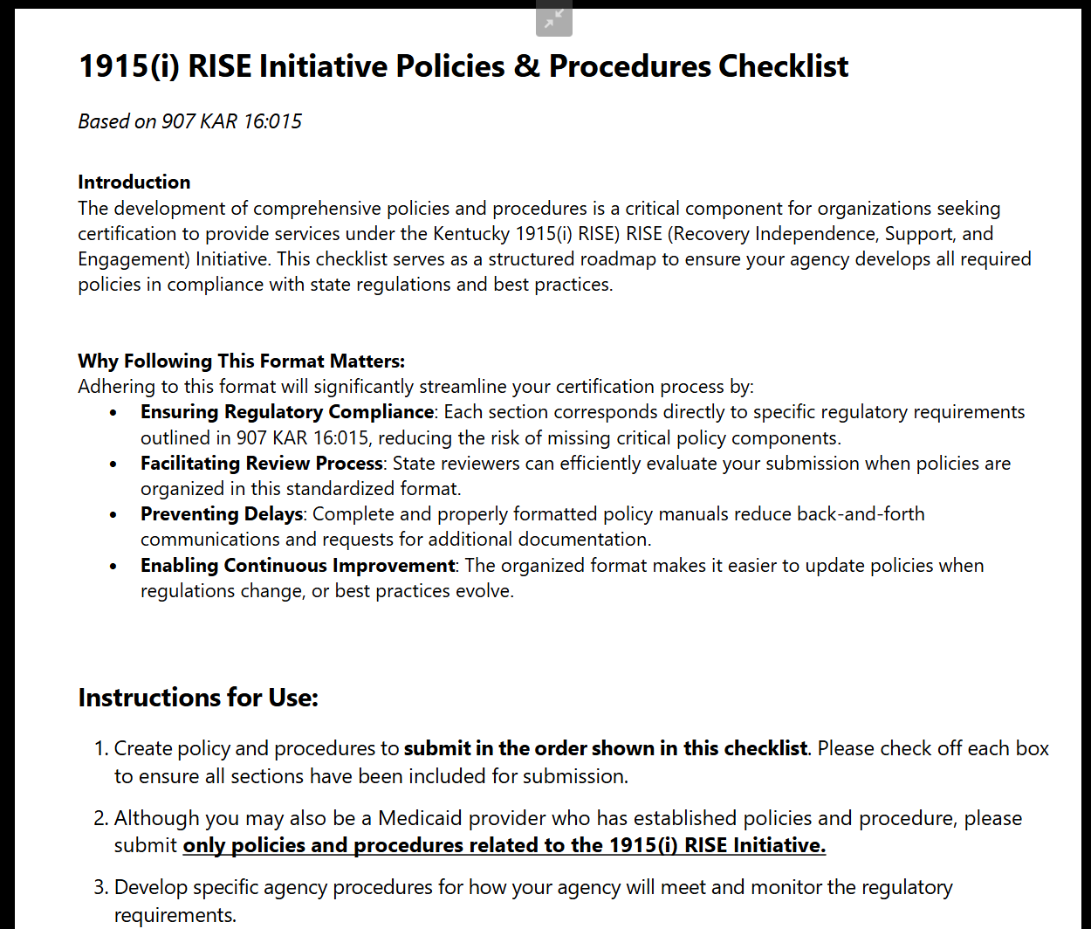
1915(i) RISE Initiative Policies and Procedures Checklist
Inside the Kentucky 1915(i) RISE ALM system, providers can find a module on the Policies and Procedures Checklist (based on KAR Chapter 16, Regulation 15)
(document is available in the ALM system and by email to state staff)
csh.org

Slide 35
1915(i) RISE Initiative Policies and Procedures Checklist
Governance and Missions Policies (e.g., Mission statement, values statement and agency governance overview)
Admission and Service Management Policies (e.g., case management, service termination, service denial documentation)
Participant Rights and Communication Policies (e.g. participant rights, participant freedom of choice, communication and interaction)
Record Management Policies (e.g., record retention, record confidentiality)
Personnel Policies (e.g., background check policy, employment prohibitions policy)
Training Policies
Health and Safety Policies (e.g., building cleaning and maintenance, household item storage policy)
Per the ALM system, Kentucky DBHIDD and DMS require providers to submit policies and procedures specific to the Kentucky 1915(i)RISE program (specified in KAR Chapter 16, Regulation 15) on:
csh.org

Slide 36
1915(i) RISE Initiative Policies and Procedures Checklist
Medication Administration
Service Delivery Policies (e.g., service definitions, person-centered service plans)
Operational Documentation Policies
Technology and Data Policies
Incident Reporting Policies
Per the ALM system, Kentucky DBHIDD and DMS require providers to submit policies and procedures specific to the Kentucky 1915(i)RISE program (specified in KAR Chapter 16, Regulation 15) on:
csh.org

Slide 37
Kentucky 1915(i) RISE Policy and Procedures Submission Details
The Governance and Mission Policy section (Section 1) must include:
Your organization’s mission and values statement, and include language about how the organization supports the 1915 initiative goals and person-centered care principles central to home and community-based services
A resource that clearly describes your agency’s governance structure, including board member titles, a list of duties, and procedures for appointing a new director
A section on policy maintenance to align with 1915(i) RISE practice/regulation changes
csh.org

Slide 38
Kentucky 1915(i) RISE Policy and Procedures Submission Details
The Admission and Service Management Policy section (Section 2) must include:
Your organization’s admission policies and procedures
A section that describes how service denials are documented and shared
A section that describes how service termination – both voluntary and involuntary – is documented and shared
A section that describes your organization’s transition planning procedures (including admission transmissions, documentation and case management)
A section on conflict-free case management procedures for specific exemptions
The annual case management functional assessment process
csh.org

Slide 39
Kentucky 1915(i) RISE Policy and Procedures Submission Details
The Participant Rights and Communication Policies section (Section 3) must include:
A sample form describing participant rights while participating in the Kentucky 1915(i) RISE program
A detailed participant rights policy document
A detailed freedom of choice policy, with details ensuring that each participant has the right to privacy and choice of service options under the Kentucky 1915(i) RISE program
A section on the organization’s communication and interaction policies and procedures
A section on the organization’s grievance and appeals system
csh.org

Slide 40
Kentucky 1915(i) RISE Policy and Procedures Submission Details
The Record Management Policies section (Section 4) must include:
A list of which participant records will be kept and maintained, and for how long
A procedure that describes how participant records and personal information will be kept confidential
A policy on how your organization creates, transmits, stores, and uses electronic signatures and electronic documents
Written procedures on the availability of record availability, including how to share information with participants, legal guardians, Kentucky Protection and Advocacy, and internal investigations if needed
csh.org

Slide 41
Kentucky 1915(i) RISE Policy and Procedures Submission Details
The Personnel Policies section (Section 5) must include:
Personnel guidelines to identify adequate staffing to implement billed services, annual evaluations, corrective action procedures, and ethical behavior standards
Your organization’s background check policy, including standards for drug testing, annual random background/registry checks
Your organization’s TB risk assessment policy
Your employment prohibition policy defining what would limit employment and volunteers
Job descriptions for roles that would provide support for 1915(i) RISE services at your organization
csh.org

Slide 42
Kentucky 1915(i) RISE Policy and Procedures Submission Details
The Training Policies section (Section 6) must include:
Your organization’s training requirements, including position-specific requirements, completion timeframes, competency verification methods, and orientation details
Your organization’s face-to-face training documentation requirements
Your organization’s web-based training documentation requirements
Your organization’s case management procedures and code of ethics (if your organization plans to provide this 1915(i) RISE service)
csh.org

Slide 43
Kentucky 1915(i) RISE Policy and Procedures Submission Details
The Health and Safety Policies section (Section 7) must include:
Your organization’s infection control plan
Your organization’s facility cleaning and maintenance procedures
An organization-wide water supply policy to ensure that your organization has an ample supply of hot and cold water
Safe household item storage procedures
A section on fire safety equipment requirements
Your organization’s policy on ensuring each participant’s nutrition and food supply needs
Organizational procedures to ensure a smoke-free environment
A section on storage, maintenance, and safety of deadly weapons
A section on your organization’s emergency and disaster guidelines
csh.org

Slide 44
Kentucky 1915(i) RISE Policy and Procedures Submission Details
The Medication and Administration section (Section 8) must include:
Your organization’s medication administration policy and procedures for case managers, and identified specific trainings, and documentation competency requirements
Your organization’s ongoing monitoring for medication administration
csh.org

Slide 45
Kentucky 1915(i) RISE Policy and Procedures Submission Details
The Service Delivery Policies section (Section 9) must include:
Service definitions (only for the services that your organization plans to provide under the Kentucky 1915(i) program), including regulatory requirements under KAR Chapter 16, agency-specific procedures, and monitoring procedures for those services
Your organization’s procedures on person-centered service plans for case management
Your organization’s service delivery procedures for telehealth services (if applicable)
Your organization’s fiscal documentation procedures (if your organization plans to manage funds for eligible participants)
A section on determining charges for room and board (residential services)
csh.org

Slide 46
Kentucky 1915(i) RISE Policy and Procedures Submission Details
The Operational Documentation Policies section (Section 10) must include:
Agency operations for organizational structure and timelines for updates
Your organization’s quality improvement plan, monitoring how program findings, corrective actions, and case management quality assurance monitoring are documented, and 1915(i) RISE program goal progress
Your organization’s Human Rights Committee Participation policies and procedures
csh.org

Slide 47
Kentucky 1915(i) RISE Policy and Procedures Submission Details
The Technology and Data Policies section (Section 11) must include:
A policy related to use of the Medicaid Waiver Management Application (MWMA) (for permanent solution only), including how the organization administrator is determined, a training plan for accurate use of MWMA, and ensuring all employees who use MWMA have access to the current materials stored in ALM
csh.org

Slide 48
Kentucky 1915(i) RISE Policy and Procedures Submission Details
The Incident Reporting Policies section (Section 12) must include:
Your organization’s incident reporting protocols (as defined by the Kentucky Department for Medicaid Services), including incident reporting procedures, party notification, root cause determination, recurrence prevention, and abuse/neglect/exploitation reporting
csh.org

Slide 49
1915(i) RISE Initiative Policies and Procedures Requirements
  Document must include a Table of Contents
  A completed Policy Checklist. The checklist is to ensure you have addressed all necessary policies. Starting on page 2, you will need to indicate in the left-hand column the policy number that corresponds with each identified policy requirement. The checklist will be provided to you when you receive your material for New Provider Orientation, or you can email 1915iRISEprovider@ky.gov to request a copy.
  Each policy shall have its own distinct number.
  If the agency plans to also provide other waiver or State Plan services, each policy shall clearly identify which program it applies to.
  Specify any differences in the policies to accommodate the differences in Kentucky’s waiver and state plan regulations.
Per the RISE Initiative Provider Certification Packet, your agency’s Policies and Procedures
csh.org

Slide 50
1915(i) RISE Initiative Policies and Procedures Checklist
Don’t start from scratch:
Please review the Kentucky iRISE Provider Policies and Procedures Template document shared. Please also start with your existing documents: many could fit the requirements with minor changes.
Per the ALM system, Kentucky DBHIDD and DMS require providers to submit policies on:
csh.org

Slide 51

Planning for Your Agency
csh.org

Slide 52
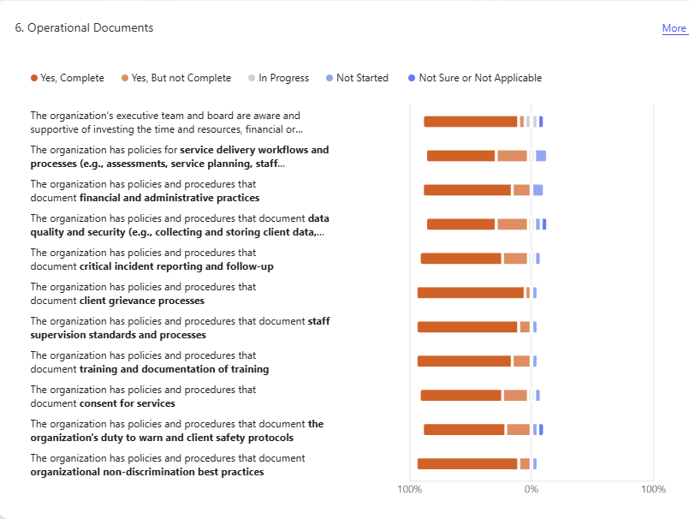
Operational Questions from Kentucky Provider Readiness Assessment
GOOD NEWS: Kentucky providers are already starting from a solid knowledge foundation!
90% of respondents said they have client grievance processes already in place
84% of respondents said they have staff supervision and review standards
84% of respondents said they have non-discrimination best practices already in place
58% of respondents said they have service delivery workflows and processes completed
csh.org

Slide 53
Open Lines of Communication
Policy and procedure changes require continued communication – and improvement
Collaborative, informed communication is integral to Kentucky 1915(i) RISE program policy requirements (see the Communication Policies Section)
When communicating the need for policies and procedure changes, consider:
  What mechanisms do you have in place for staff to report issues and concerns? Anonymously and without retaliation?
  What mechanisms do you have in place to share important information with staff?
  What mechanisms do you have in place to share information with your Board? Regular meetings with direct communication with the compliance program?
csh.org
Notes:
Give some examples
Leave some time for tables/groups to come up with ideas around a specific question and report back
Have open lines of communication between you and employees. –
Maintain an anonymous “hotline” to report issues to you. –
Enforce a non-retaliation policy for employees who report potential problems.
Establish a direct line of communication between you and the Board. –
Use surveys or other tools to get feedback on training and on the compliance program.
Use newsletters or internal websites to maintain visibility with employees.
Regularly meet with the Board and brief them on the compliance program.

Slide 54

Training and Education Programs
Regularly review and update training programs. Use “real-life” examples.
Make training completion a part of onboarding, a regular job requirement and requirement for the Board.
Test employees’ understanding of training topics.
Maintain documentation to show which employees received training and can be easily shared with state monitors.
csh.org
Notes:
We are working on a one pager with all the trainings and links
This might be better as a discussion vs just being told/given examples. Have people give examples of their training; maybe wish lists

Slide 55
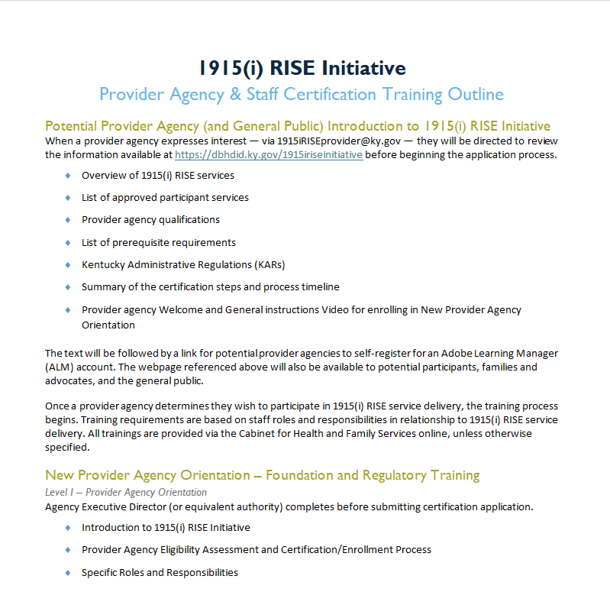
Provider Agency and Staff Certification Training Outline
The 1915i RISE Provider Resource Documents site lists the Provider Agency and Staff Certification Training Outline
csh.org
Notes:
Note that the document linked to, lists all required trainings from start up to ongoing operations. State will be updating as the program evolves. Agencies should be organizing their LMS for RISE using this checklist.

Slide 56
Training in the Kentucky 1915(i) RISE ALM System
Note: There are several training sessions on key topics (e.g., de-escalation, person-centered care planning and more!) as part of the 1915i RISE Level III (Phase 1, 2 and 3) Provider Agency Staff training in the ALM system (all required courses for providers)
Different 1915(i) RISE staff need to attend, graduate from and document training for state monitoring efforts.
csh.org

Slide 57
Planning for Updates: When reviewing your agency's policies and procedures list and contents, consider:
What needs to be added?
What needs to be revised?
What needs to be started?
Who is the agency lead on policies and procedures?
What state are your current policies and procedures in?
Who is leading the revisions needed to meet the Kentucky 1915(i) policies and procedures requirements?
How are we gathering feedback from our staff and service participants to inform the revision process?
csh.org

Slide 58
Wrapping Up
Policies – what do you already have? What do you need to add? What do you need to revise based on new/ different requirments?
Policies- what you do / Procedures- how you do; should be informed by staff and clients
Policies reviewed and approved by Board of Directors
Procedures - Don’t normally have to be approved by the Board, easier to revise
Policies and procedures reviewed annually to meet changing needs of organization and achieve compliance with laws, rules, and funding requirements
Process for policy and procedure development and approval
Training plan for onboarding and ongoing
Learning and Improvement
csh.org

Slide 59

Thank you!
csh.org

